Slide 1
5th grade!
It’s going to be the best!

Slide 2
HAPPY NEW school YEAR!

Slide 3
Introductions
I’m Joseph Heine
12th year teaching
6th in 5th grade
I’ve spent four years in 4th and two in Kindergarten

Slide 4
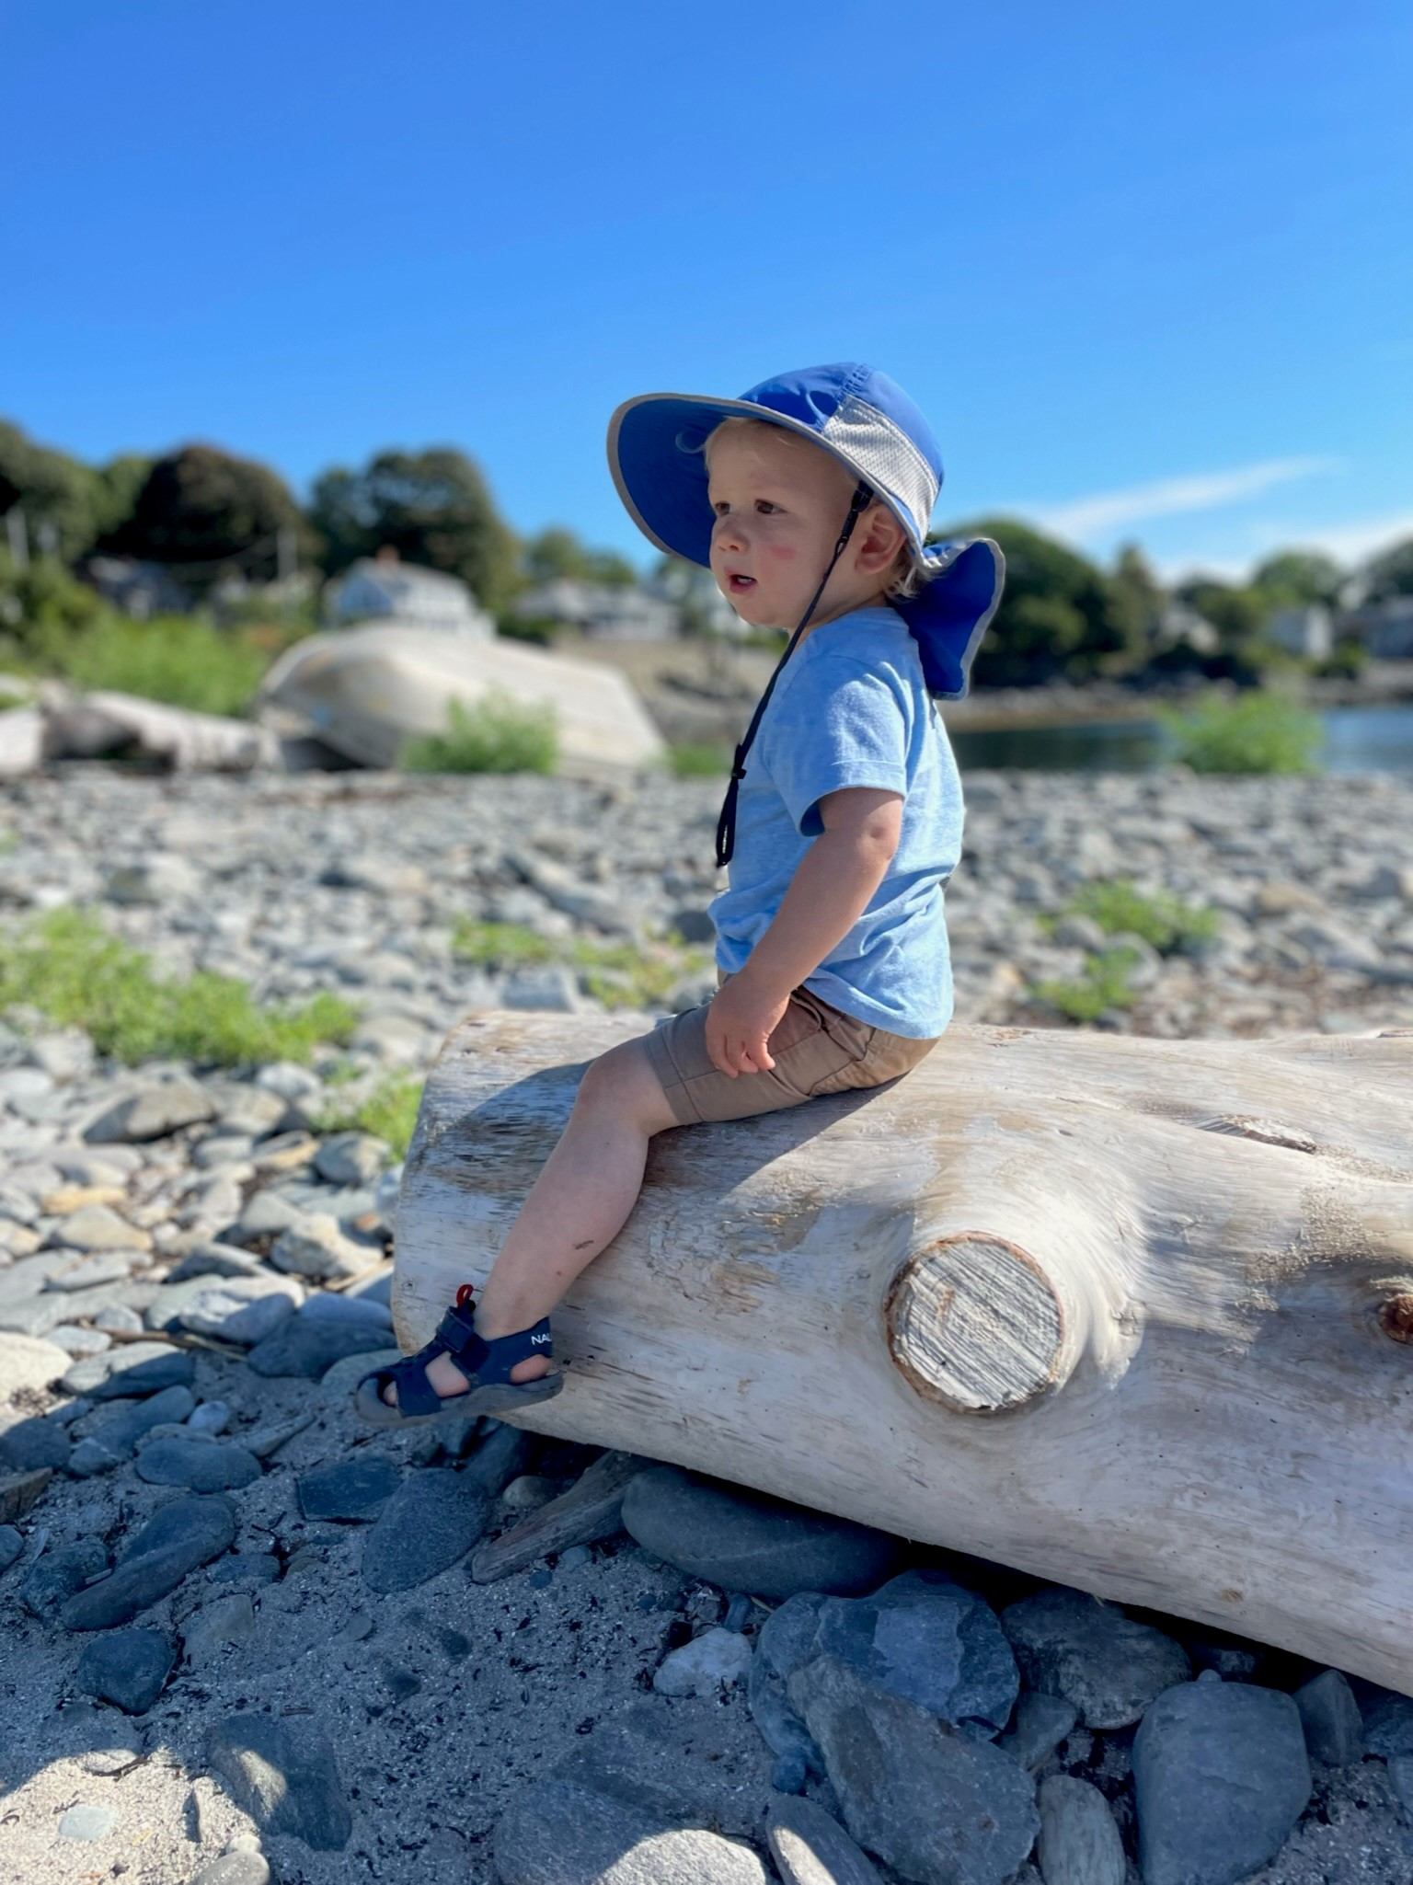
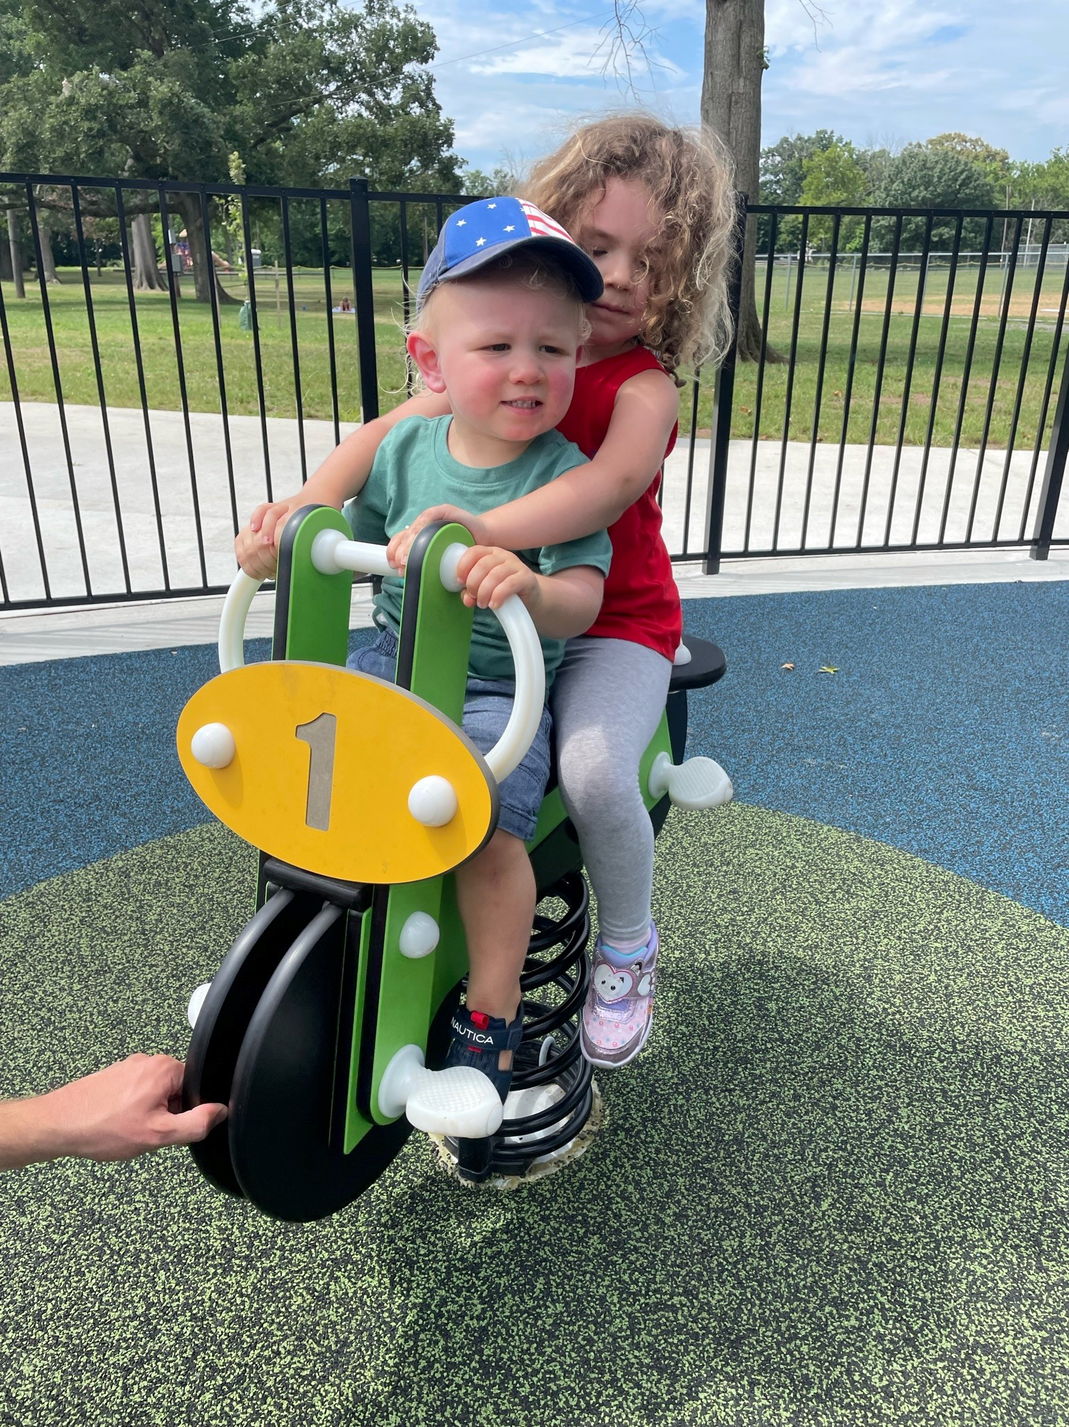
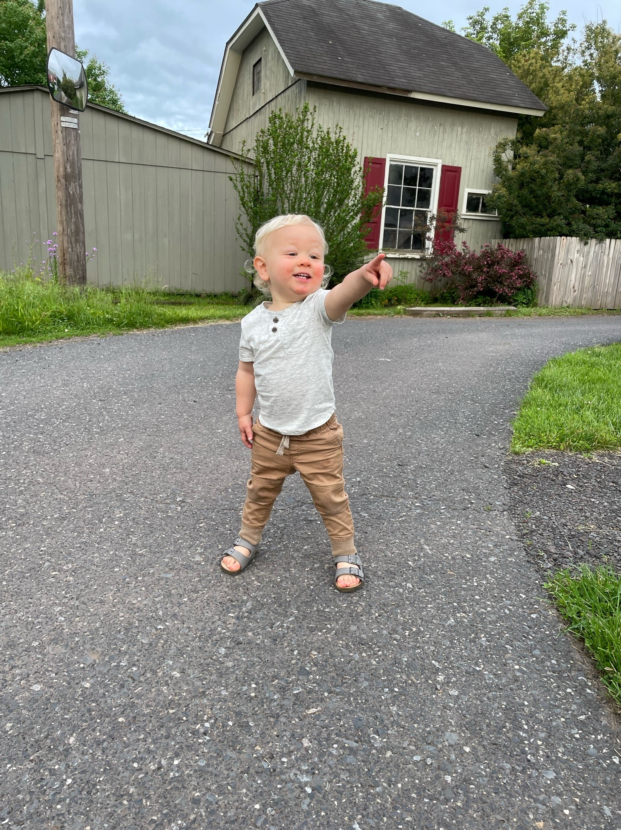
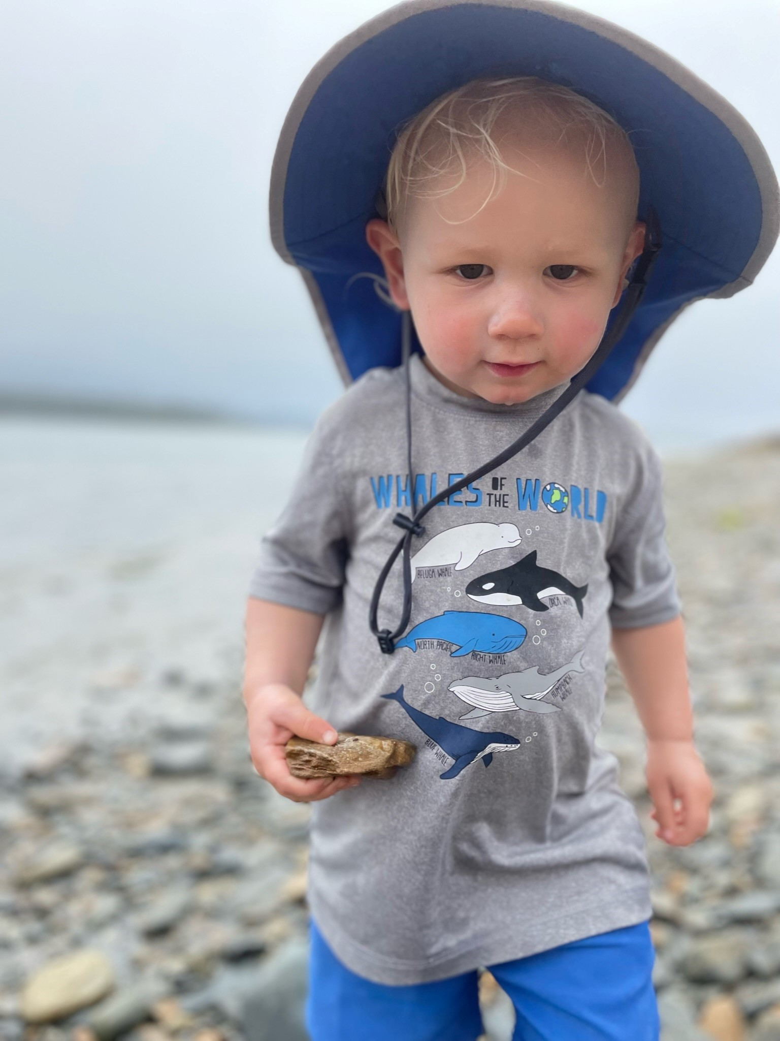
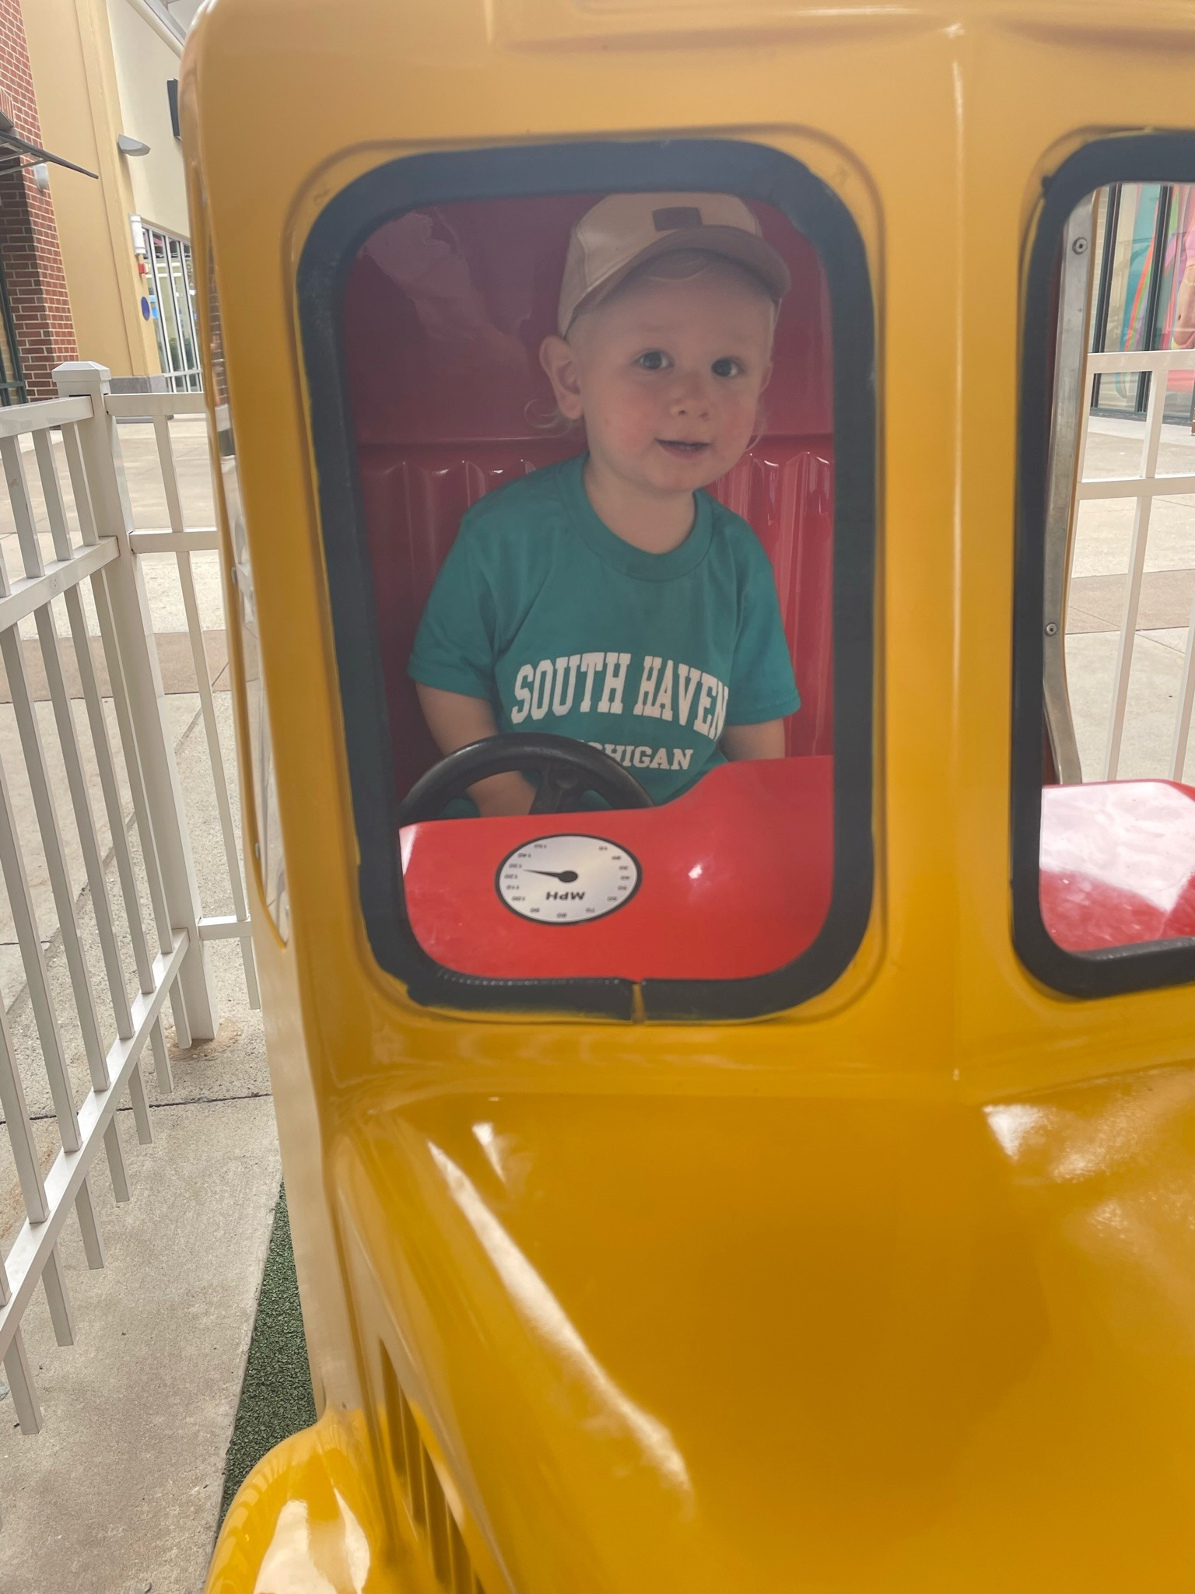
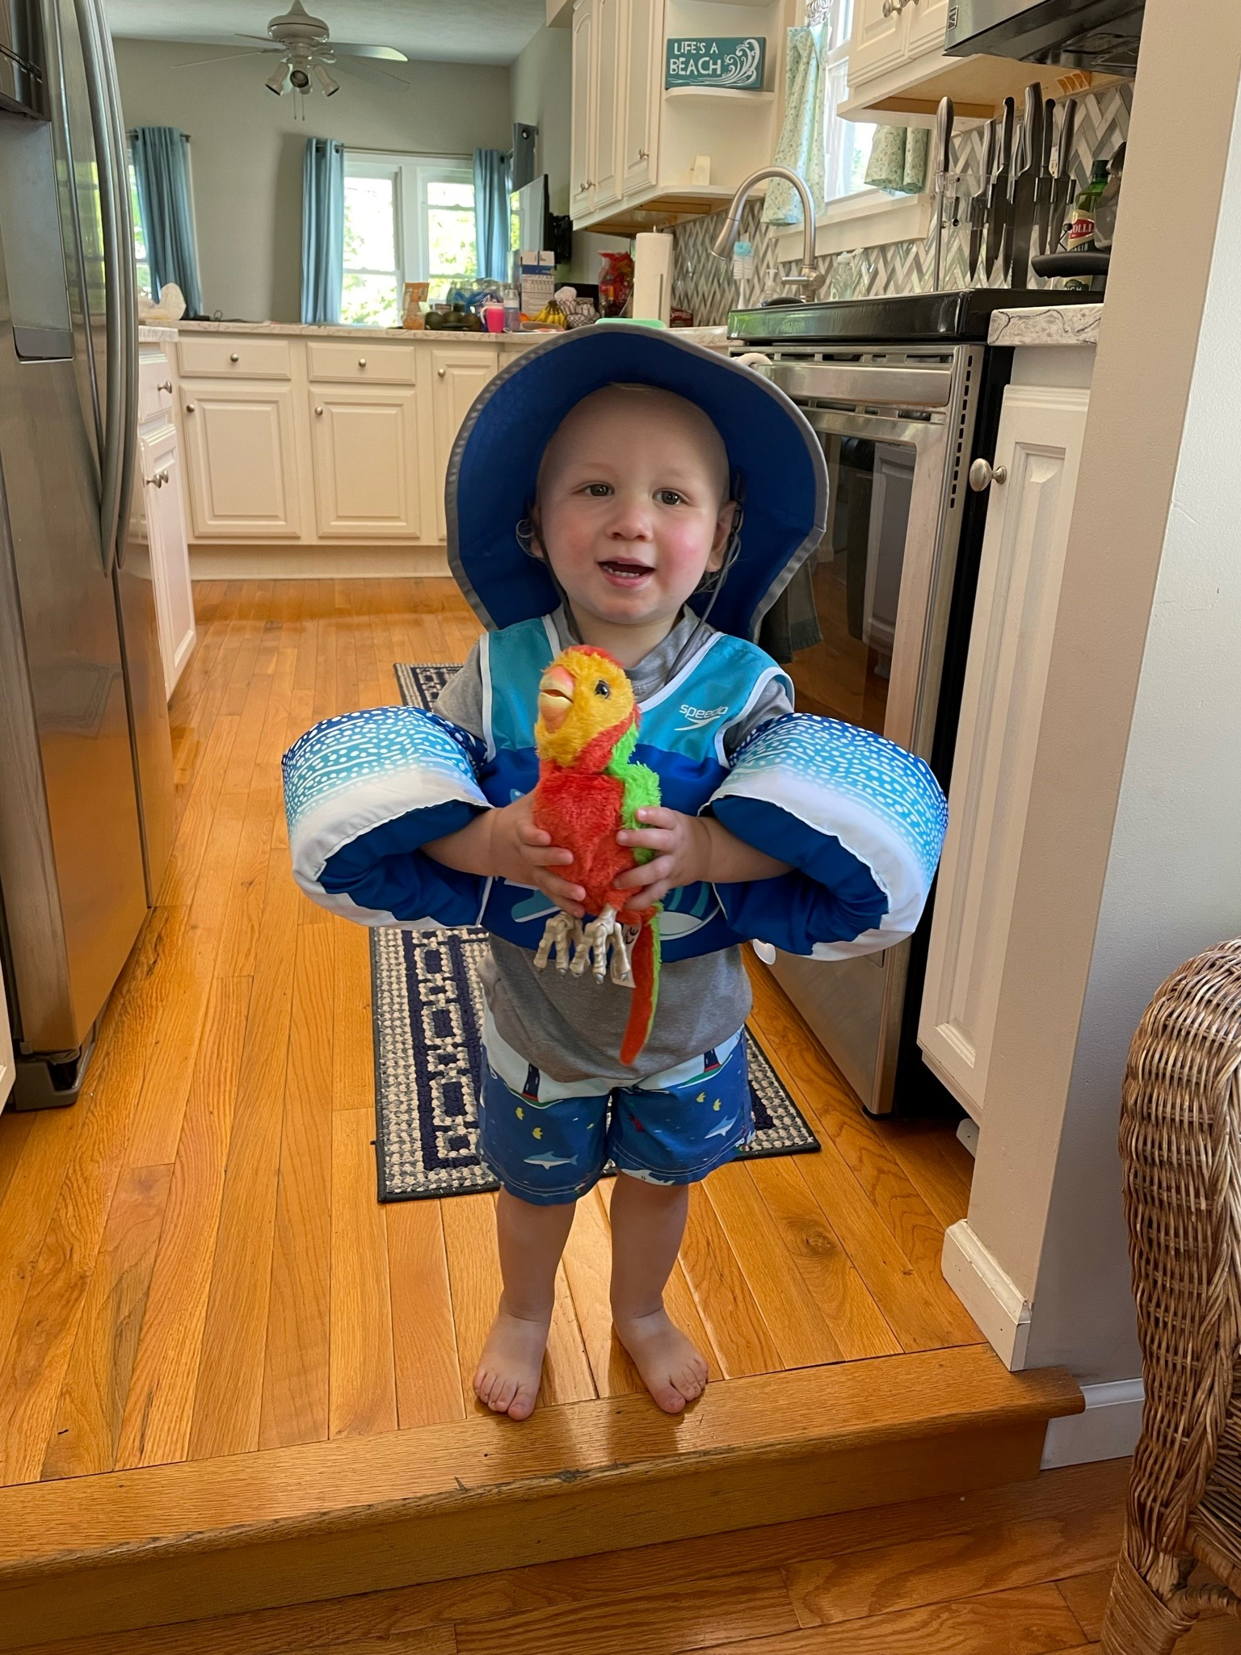
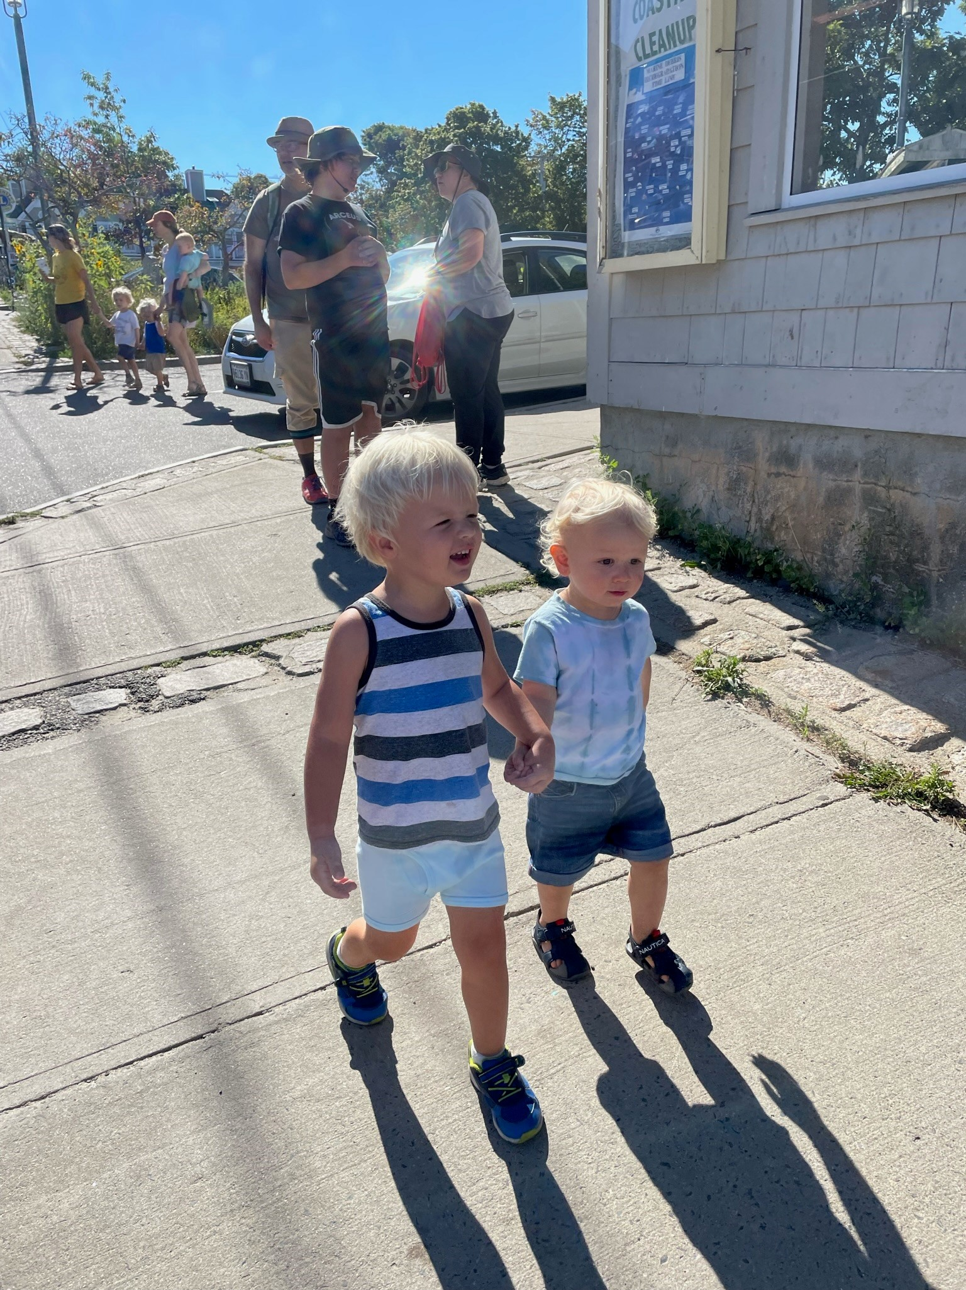
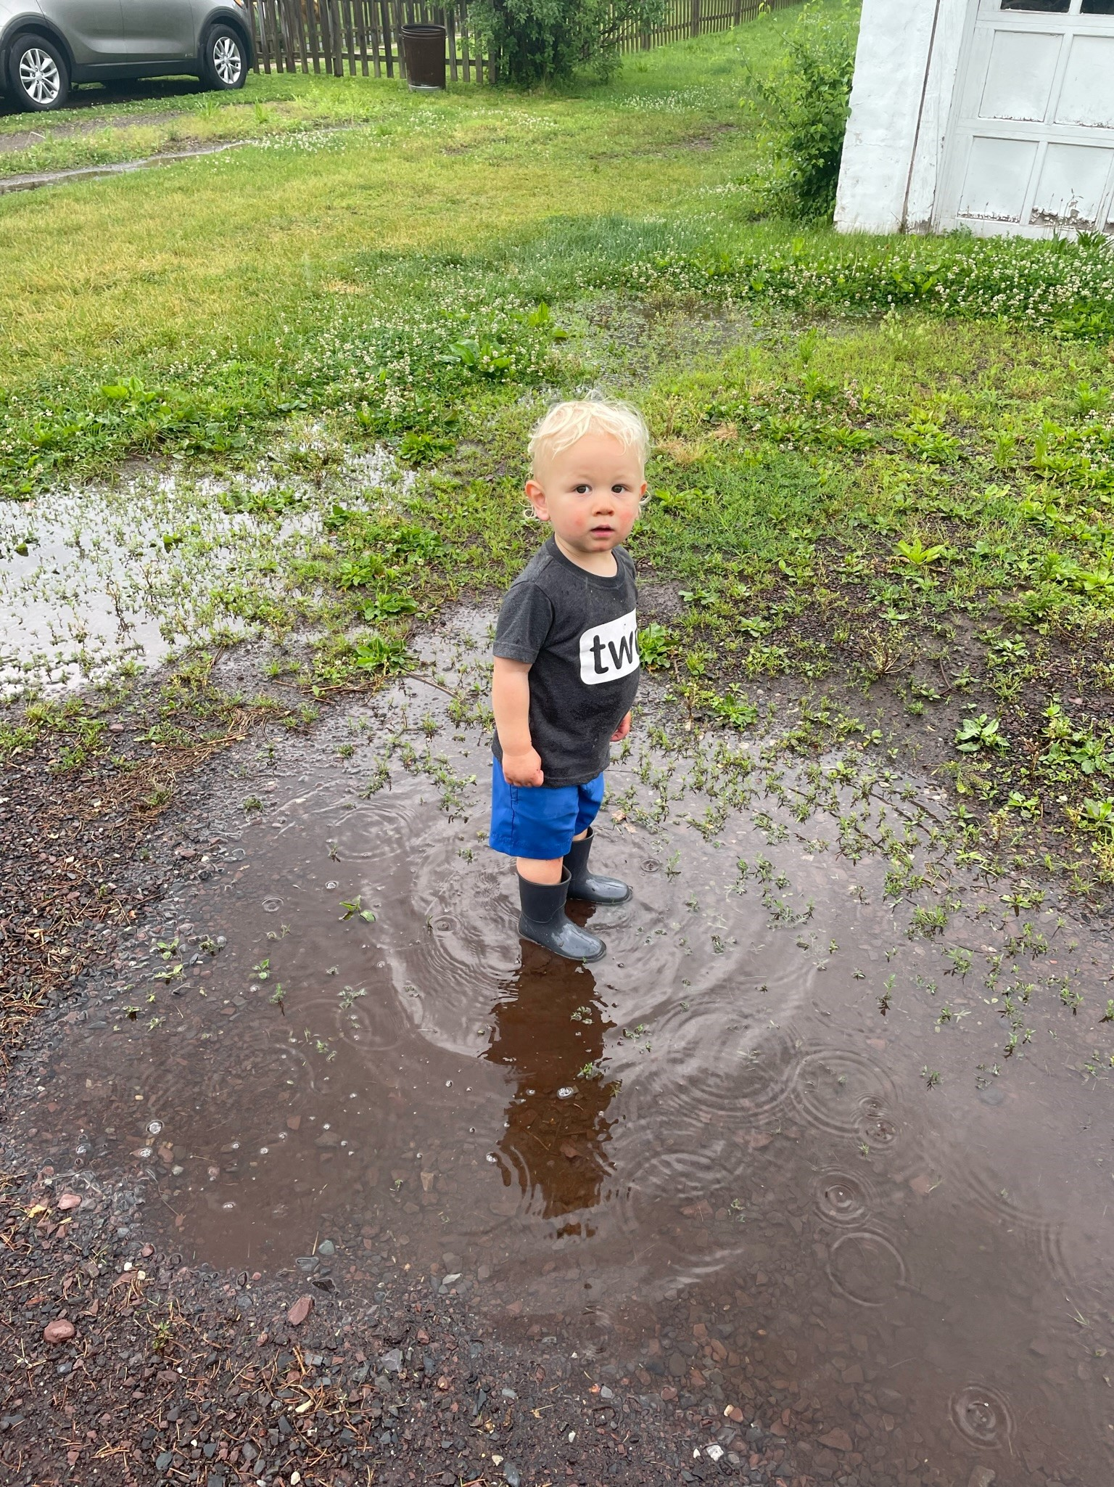
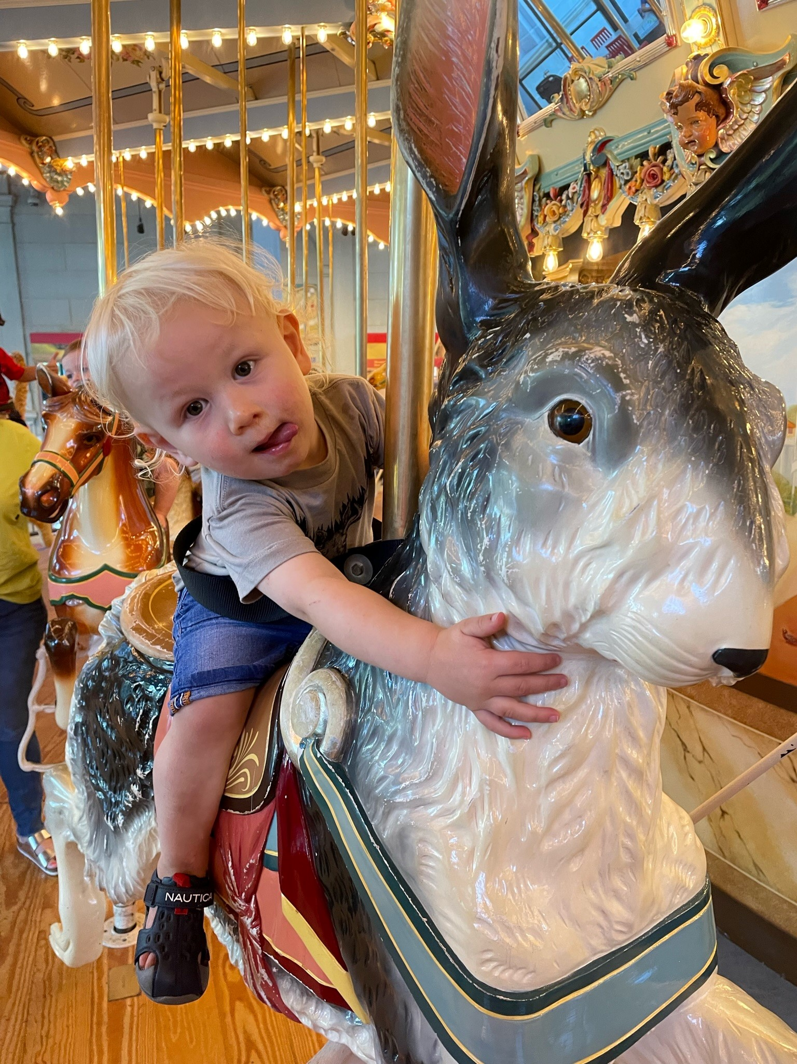
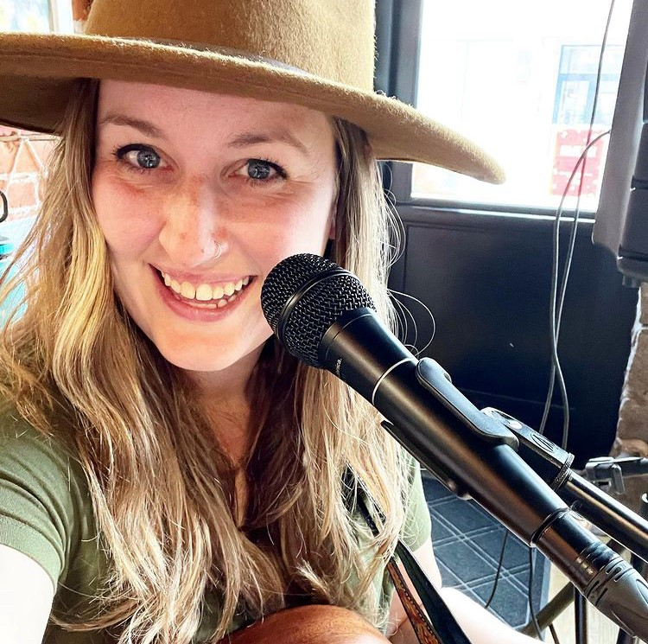
My family!

Slide 5
My teaching philosophy
I believe in the importance of educating the whole child.
Build confidence
Encourage students to take ownership of their education
Challenge each student academically
Develop communication skills needed in school and society

Slide 6
Parent communication
I want to provide you with meaningful communication.
How can I go about doing that?
-Test reminders: typically, a week before a test.
-Whole class reminders: field trips, class rewards, etc.
-Individual emails for academic or behavior concerns.
Please be sure to read Mr. Finger’s Warwick Weekly and Principally Speaking.

Slide 7
Dismissal
Please make me aware of any changes in dismissal.
If you need to make a last minute change please call the office.

Slide 8
Contacting me
JHEINE@CBSD.ORG
We can always set up a check-in Teams call or phone call.

Slide 9
A day in the life…
Day 1-Art Day 2-Library Day 3-P. E. Day 4- QUEST Day 5- Music
 | Monday | Tuesday | Wednesday | Thursday (Day 4) | Friday
9:10-9:25 | Morning Meeting | Morning Meeting | Morning Meeting | Morning Meeting | Morning Meeting
9:25-10:30 | Math | Math | Math | Math | Math
10:30-11:00 | WIN | WIN | WIN | WIN | WIN
11:00-12:00 | Recess/Lunch | Recess/Lunch | Recess/Lunch | Recess/Lunch | Recess/Lunch
12:00-12:30 | RELA | RELA | RELA | RELA 12-1:20 | RELA
12:30-1:10 | Special | Special | Special | Special 1:20-2:00 | Special
1:10-2:50 | RELA | RELA | RELA | RELA 2-2:50 | RELA
2:50-3:35 | SS/Science | SS/Science | SS/Science | SS/Science | SS/Science

Slide 10
Cha Cha Changes
Increase in responsibility
Emails
Study guides/Study Sessions
Microsoft OneNote/Teams/Canvas
Set deadlines for tests/quizzes/papers

Slide 11
technology
Laptops
Bring home and charge each day.
Use case in the hallways

Slide 13
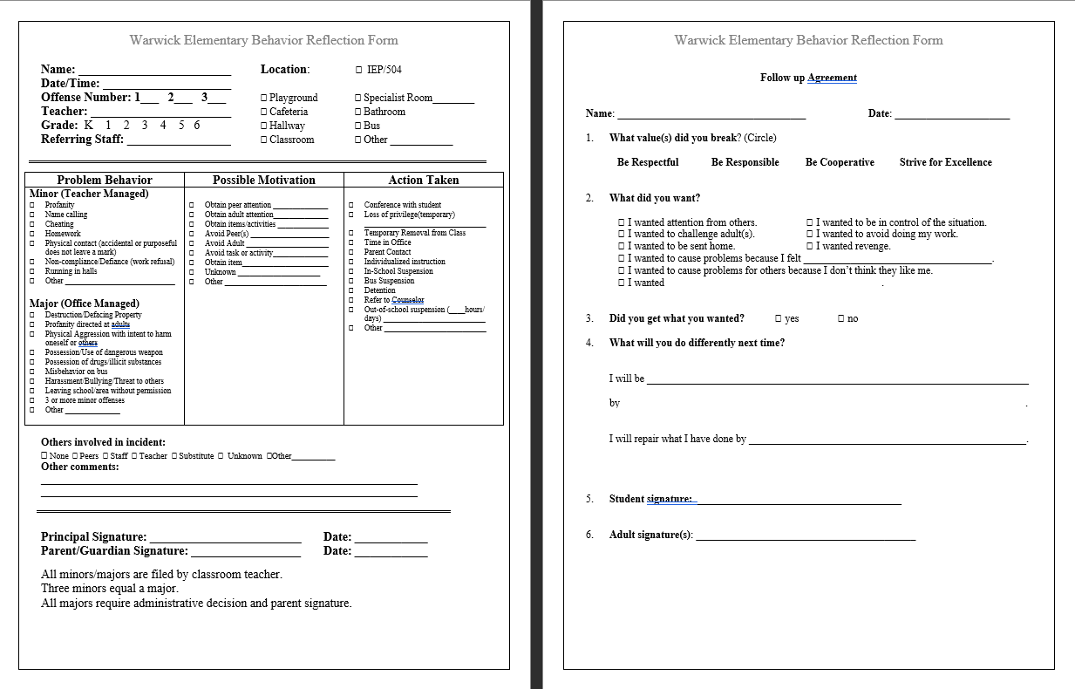

Slide 14
A message from Dr. Garvin
MTSS in Central Bucks on Vimeo

Slide 15
Curriculum
Curriculum links
This slideshow will be posted on my website for future reference.

Slide 16
Trimesters
Progress will be reported in December, April, and June in the content areas.
Specialists will report progress in December and June.
Conferences will be held in December and April.

Slide 17
Special Privileges and Events
Band and Orchestra opportunities
Peace Valley Nature Center, Ecology Field Trip
Musical- more information to come
Reading Olympics Opportunities
Genius Hour

Slide 18
My promise to you
I promise to care for your child like my very own.
I will differentiate my instruction to meet your child’s academic/emotional strengths and needs.
I am here to help so please reach out if you have concerns.
I love what I do each day and your child will know that!

Slide 19
Questions

